Slide 1
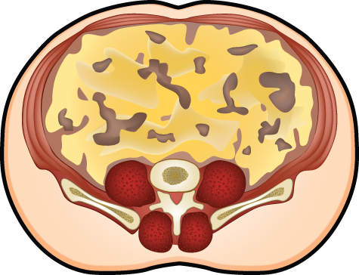
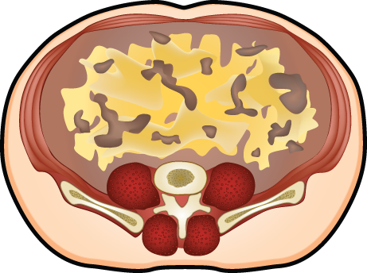
SCHEMATIC REPRESENTATION OF THE GREATER RELATIVE LOSS IN INTRA-ABDOMINAL ADIPOSE TISSUE AS COMPARED WITH SUBCUTANEOUS ADIPOSE TISSUE INDUCED BY EXERCISE TRAINING IN THE ABSENCE OF WEIGHT LOSS
Exercise without concomitant
weight loss
Mobilization of intra-abdominal
adipose tissue
Improvement of
glucose-insulin homeostasis
Risk of Type 2 Diabetes

