Slide 1
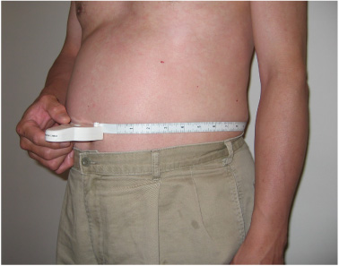
SELF-MEASURED CIRCUMFERENCE USING A MYOTAPE

