Slide 1
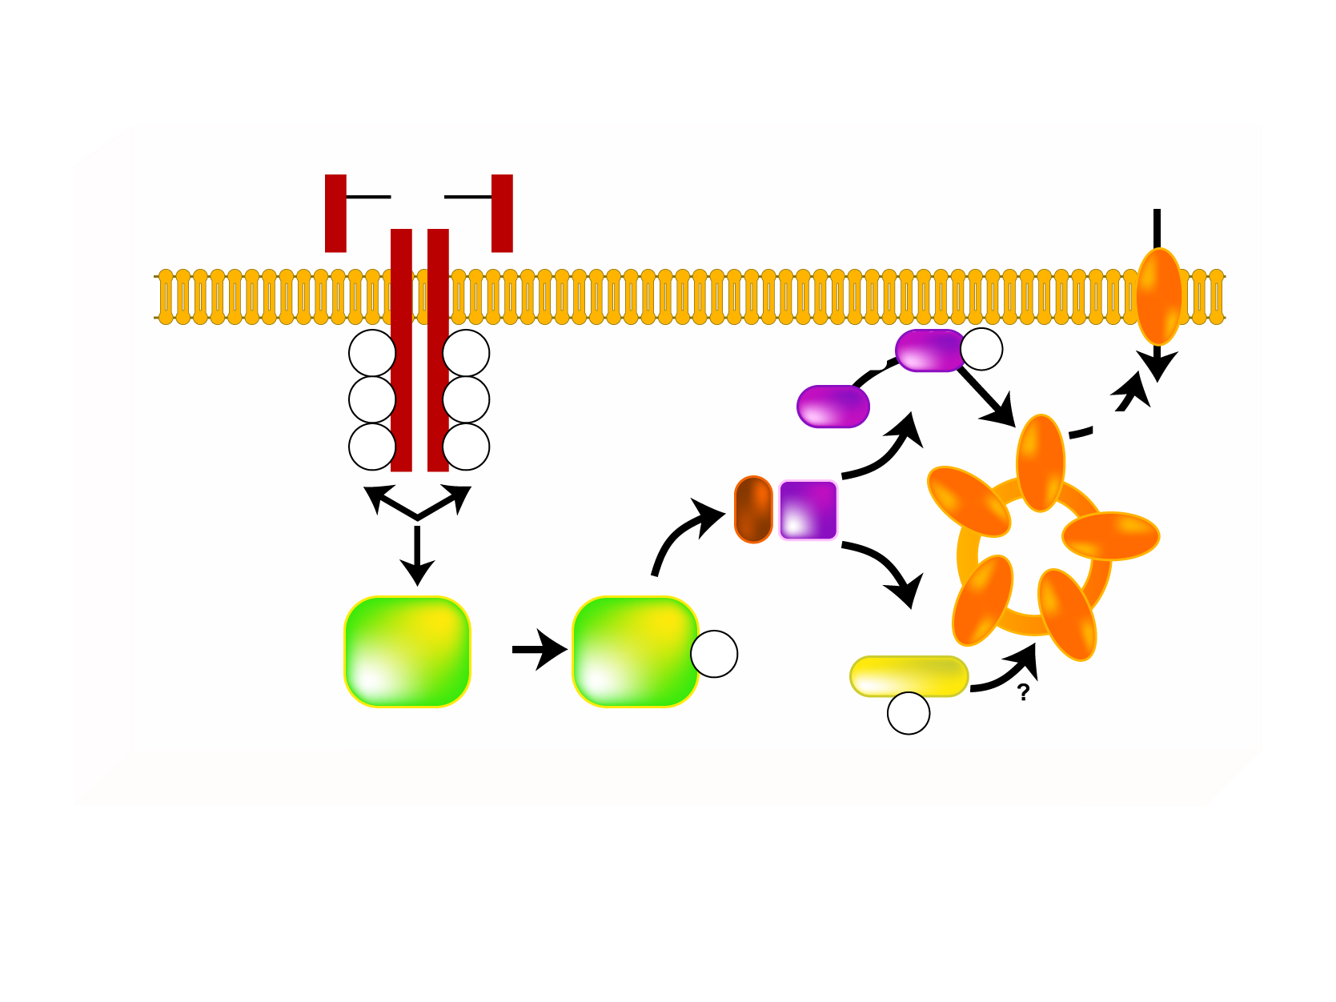
SIMPLIFIED SCHEME OF INSULIN ACTION ON GLUCOSE TRANSPORT
INSULIN
ss
GLUCOSE
ss
ss
GLUT 4
pY
pY
PDK
Akt
pS/T
pY
pY
PIP3
Akt
pY
pY
AS160
PI3K
IRS
Y
IRS
PIP3
pY
PKC-ξ/λ
pT
Legend
Akt = protein kinase PI3K= phosphatidylinositol [3,4,5) kinase
AS160 = Akt substrate of 160 kDa PKC = protein kinase C
GLUT = glucose transporter pS/T = serine/threonine phosphorylation
IRS = insulin receptor substrate-1/2 pT = threonine phosphorylation
PDK = phosphoinositide-dependent protein kinase pY = tyrosine phosphorylation
PIP3 = phosphatidylinositol 3 triphosphate

