Slide 1
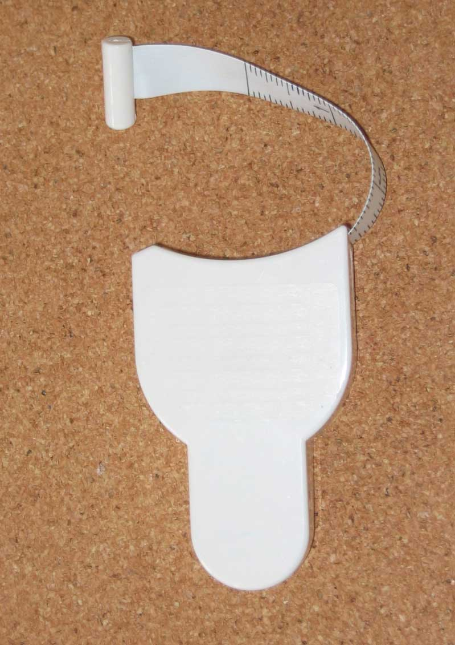
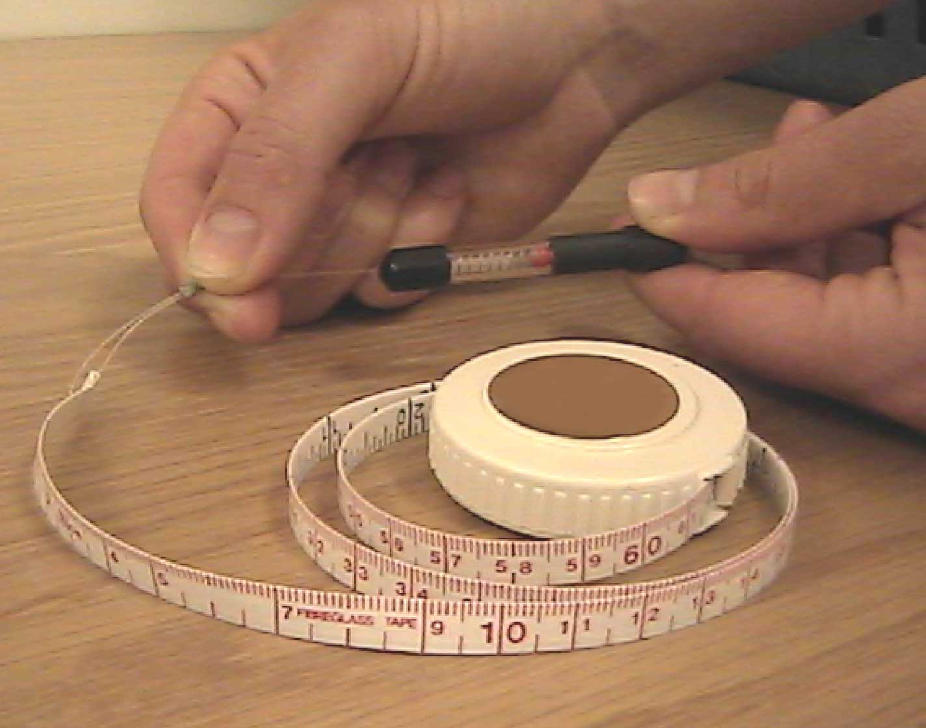
SPRING-LOADED WAIST CIRCUMFERENCE MEASUREMENT TAPES
Myotape
Gulick Tape

