Slide 1
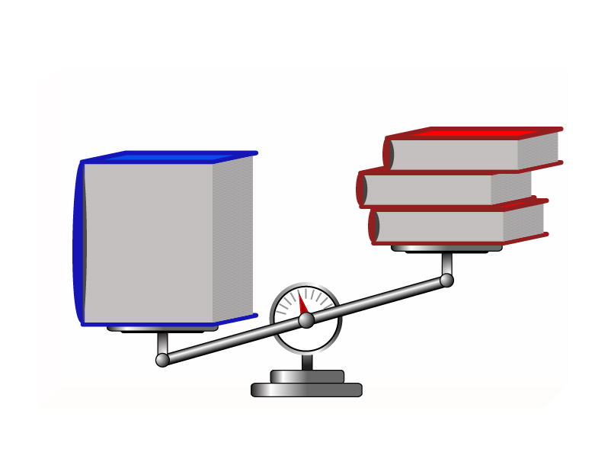
THE CONCEPT OF POSITIVE ENERGY BALANCE
Energy Intake
Energy Expenditure
Resting
(e.g. sleeping)
Physical activity
(including exercise)
Thermic effect
of food
Calories consumed
(eating)

