Slide 1
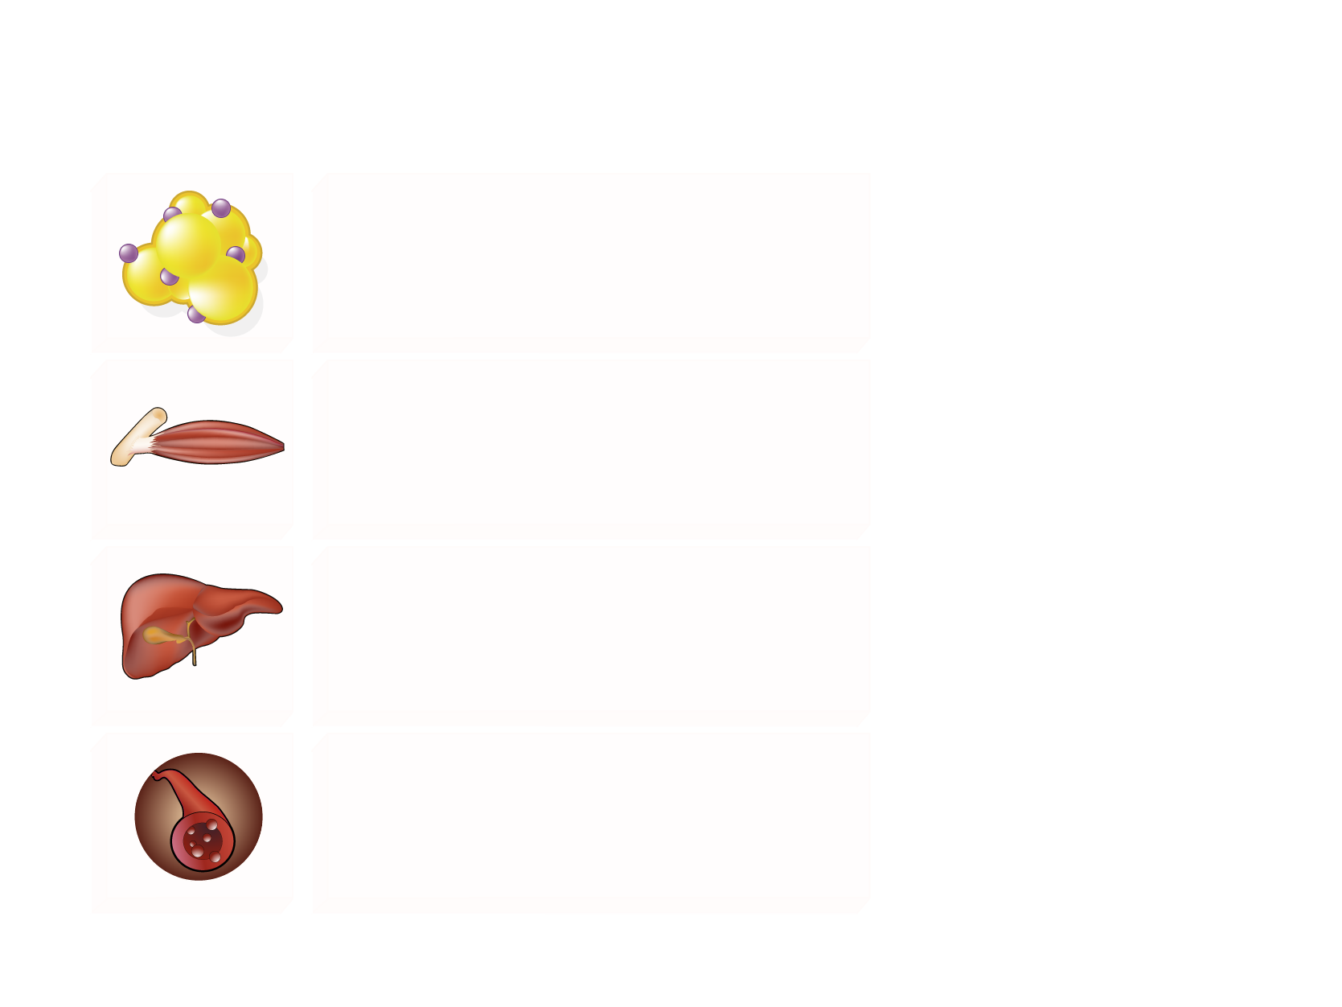
THE MANY FUNCTIONS OF INSULIN IN LIPID METABOLISM
Insulin resistance
Adipose LPL (triglyceride clearance)
Lipolysis (VLDL-triglyceride precursors)
Legend
The arrows indicate whether insulin
increases (upward green) or decreases
(downward red) the corresponding process under normal conditions of insulin sensitivity. The red Xs indicate the insulin actions that are lost in the insulin resistant state. In this condition, liver lipid synthesis is the sole insulin action maintained and is therefore exacerbated by hyperinsulinemia.
LPL = lipoprotein lipase
CETP = cholesteryl ester transfer protein
Muscle LPL (triglyceride clearance)
De novo lipid synthesis
Apo B degradation
LDL-receptor expression
VLDL assembly
VLDL secretion
Apo CIII expression
Intravascular CETP-mediated lipid transfer

