Slide 1
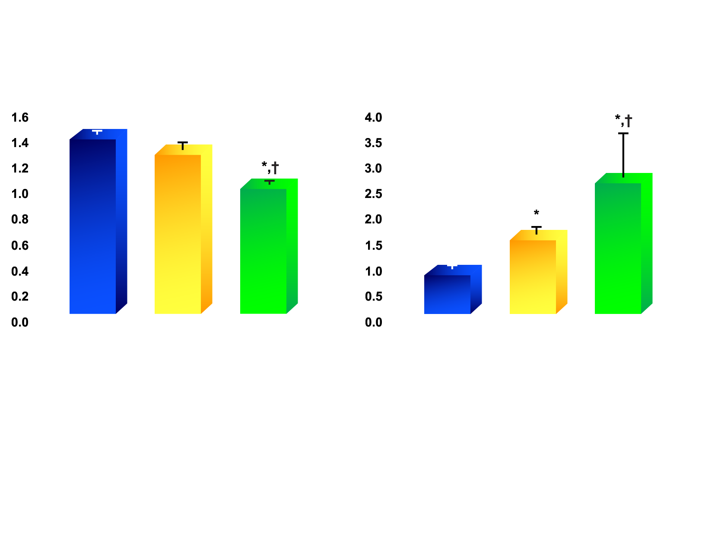
TRIGLYCERIDE AND HDL CHOLESTEROL LEVELS IN NON-OBESE WOMEN AND IN OBESE WOMEN WITH LOW OR HIGH LEVELS OF INTRA-ABDOMINAL ADIPOSE TISSUE
HDL cholesterol (mmol/l)
Triglycerides (mmol/l)
Non-obese
(N=25)
Obese with low levels of intra-abdominal fat (N=10)
Obese with high levels of intra-abdominal fat (N=10)
Non-obese
(N=25)
Obese with low levels of intra-abdominal fat (N=10)
Obese with high levels of intra-abdominal fat (N=10)
Legend
* Significantly different from non-obese women
† Significantly different from obese women with
low levels of intra-abdominal fat, p<0.05
Adapted from Després JP et al. Arteriosclerosis 1990; 10: 497·511

