Slide 1
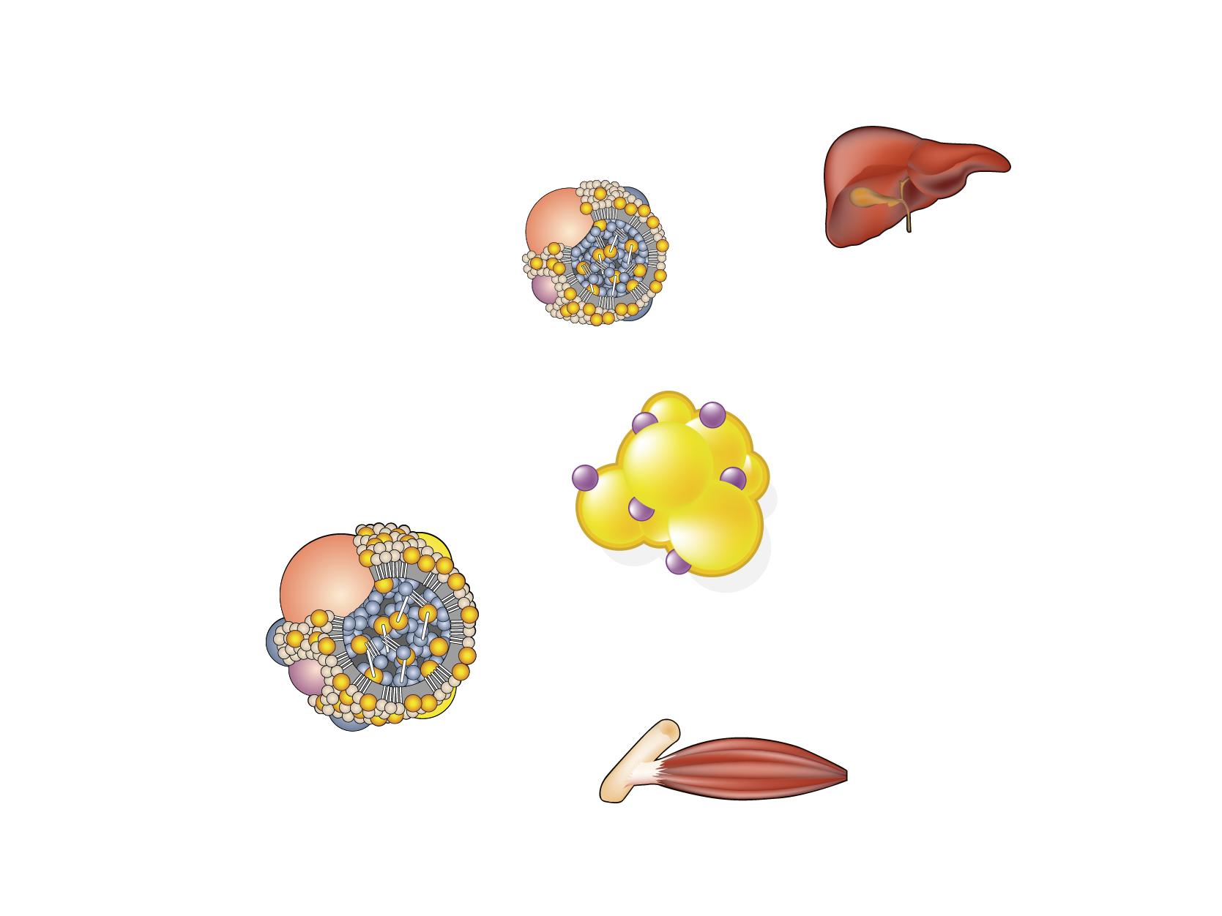
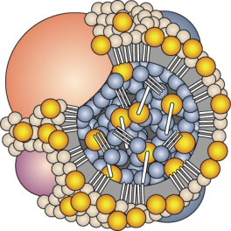
TRIGLYCERIDE TRANSPORT AND METABOLISM
Liver
Intestinal
lumen
Acetyl-CoA
Fatty acids
Dietary
triglycerides
Enterocyte
VLDL
Triglycerides
Fatty acids
Triglycerides
Adipose tissue
Albumin
Fatty acids
Triglycerides
LPL
Fatty acids
Oxidation
Chylomicron
Muscle
Legend
LPL=lipoprotein lipase

