Slide 1
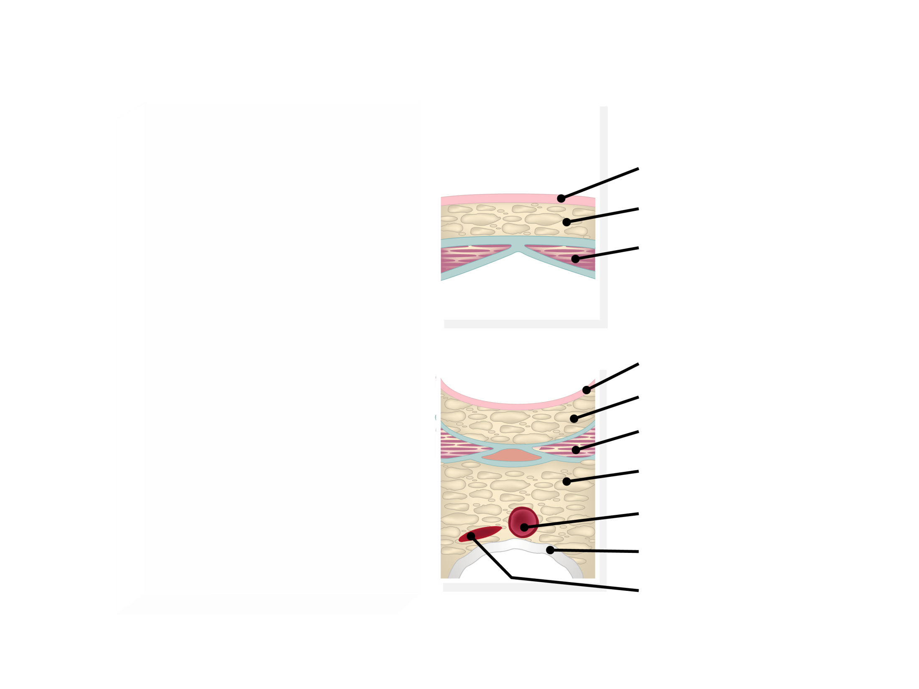
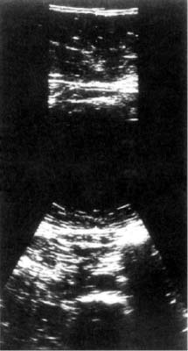
ULTRASONOGRAPHY MEASUREMENTS OF ABDOMINAL TISSUE COMPOSITION
Skin
Subcutaneous Fat
Rectus Abdominis Muscle
Skin
Subcutaneous Fat
Rectus Abdominis Muscle
Intra-abdominal Fat
Aorta
Spine
Inferior Vena Cava
Adapted from Armellini F et al. J Clin Ultrasound 1990; 18:563-7

