Slide 1
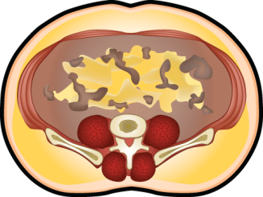
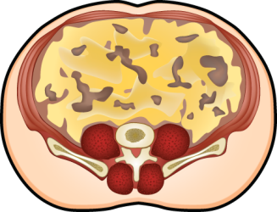
USE OF HYPERTRIGLYCERIDEMIC WAIST AS A SCREENING TOOL TO IDENTIFYING INDIVIDUALS LIKELY TO BE CHARACTERIZED BY THE CLUSTER OF ABNORMALITIES OF THE METABOLIC SYNDROME
NORMAL ADIPOSE TISSUE (FUNCTIONAL)
ABNORMAL ADIPOSE TISSUE (DYSFUNCTIONAL)
OBESITY PHENOTYPE
CLINICAL PHENOTYPE
OBESITY PHENOTYPE
CLINICAL PHENOTYPE
Subcutaneous obesity
Elevated waist girth alone
Intra-abdominal obesity
Hypertriglyceridemic waist
Waist girth
+
Waist girth
+
Favorable genotype
Healthy diet
Physically active
Insulin sensitive
Unfavorable genotype
Unhealthy diet
Sedentary
Insulin resistant
Normal
triglycerides
Eleveted
triglycerides
CORRELATES OF HYPERTRIGLYCERIDEMIC WAIST
• Atherogenic metabolic triad
• Cholesterol/HDL cholesterol
• Postprandial hyperlipidemia
• Glucose intolerance
• Hyperinsulinemia
• Blood pressure
• Risk of cardiovascular disease
• Risk of coronary artery disease
• Annual progression rate of aortic calcification
• Risk of type 2 diabetes

