Slide 1
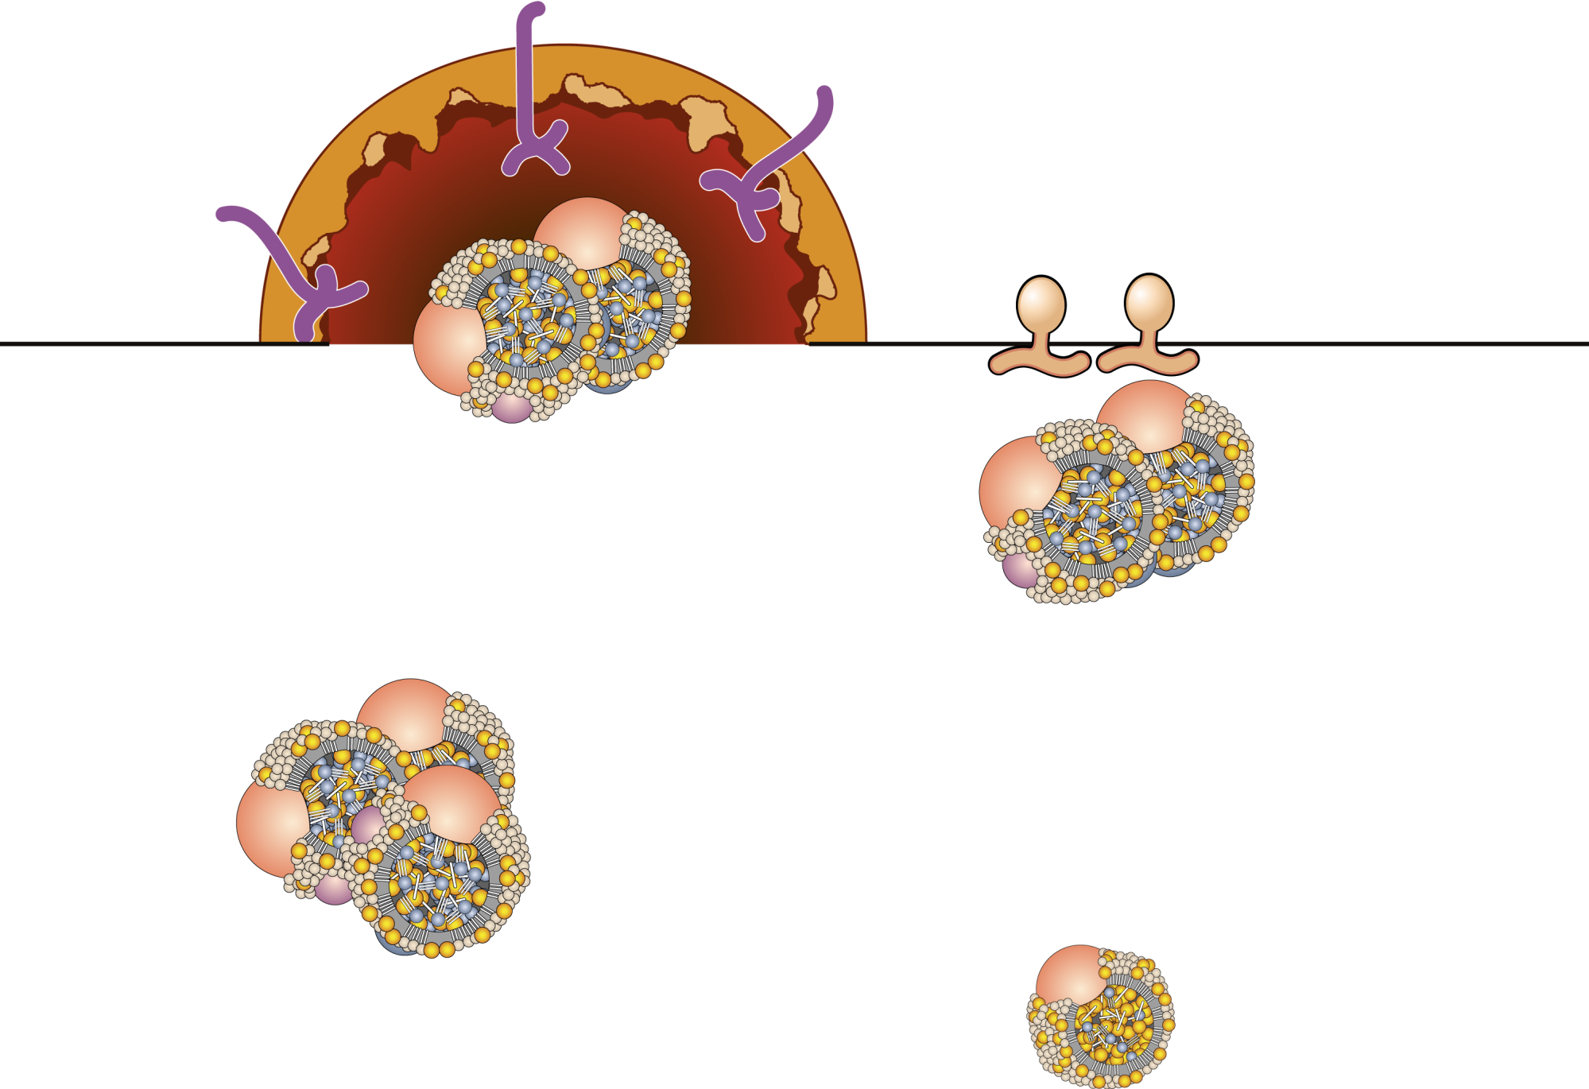
VLDL REMNANT METABOLISM
Liver uptake
(LDL receptor)
Apo B/E receptor
HTGL
Uptake by hepatic LDL receptors (60%-70%)
VLDL remnants
Hydrolysis by HTGL
(30%-40%)
Fatty acids
Apo C’s
LDL formation
Apo E’s
Legend
HTGL = hepatic triglyceride lipase
LDL

