Slide 1
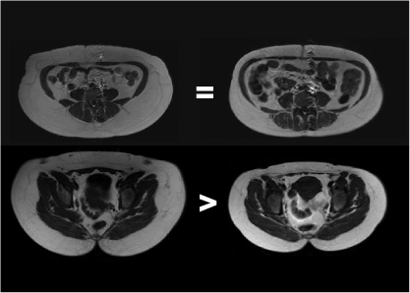
WOMEN WITH HIGH VS. LOW WAIST-TO-HIP RATIO (WHR) BUT THE SAME WAIST CIRCUMFERENCE AND INTRA-ABDOMINAL ADIPOSE TISSUE (AT)
Low WHR
High WHR
Low WHR
High WHR
WHR
0.80
0.94
Waist Level
Waist
Circumference (cm)
93.1
95.0
Intra-abdominal AT
(cm²)
116
115
Abdominal
Subcutaneous AT (cm²)
513
231
Abdominal
Subcutaneous AT (cm²)
Abdominal Skeletal Muscle (cm²)
126
105
Hip Circumference
116.7
101.5
Hip
Subcutaneous AT (cm²)
459
264
Hip Level
Hip Skeletal
Muscle (cm²)
230
187

