Slide 1
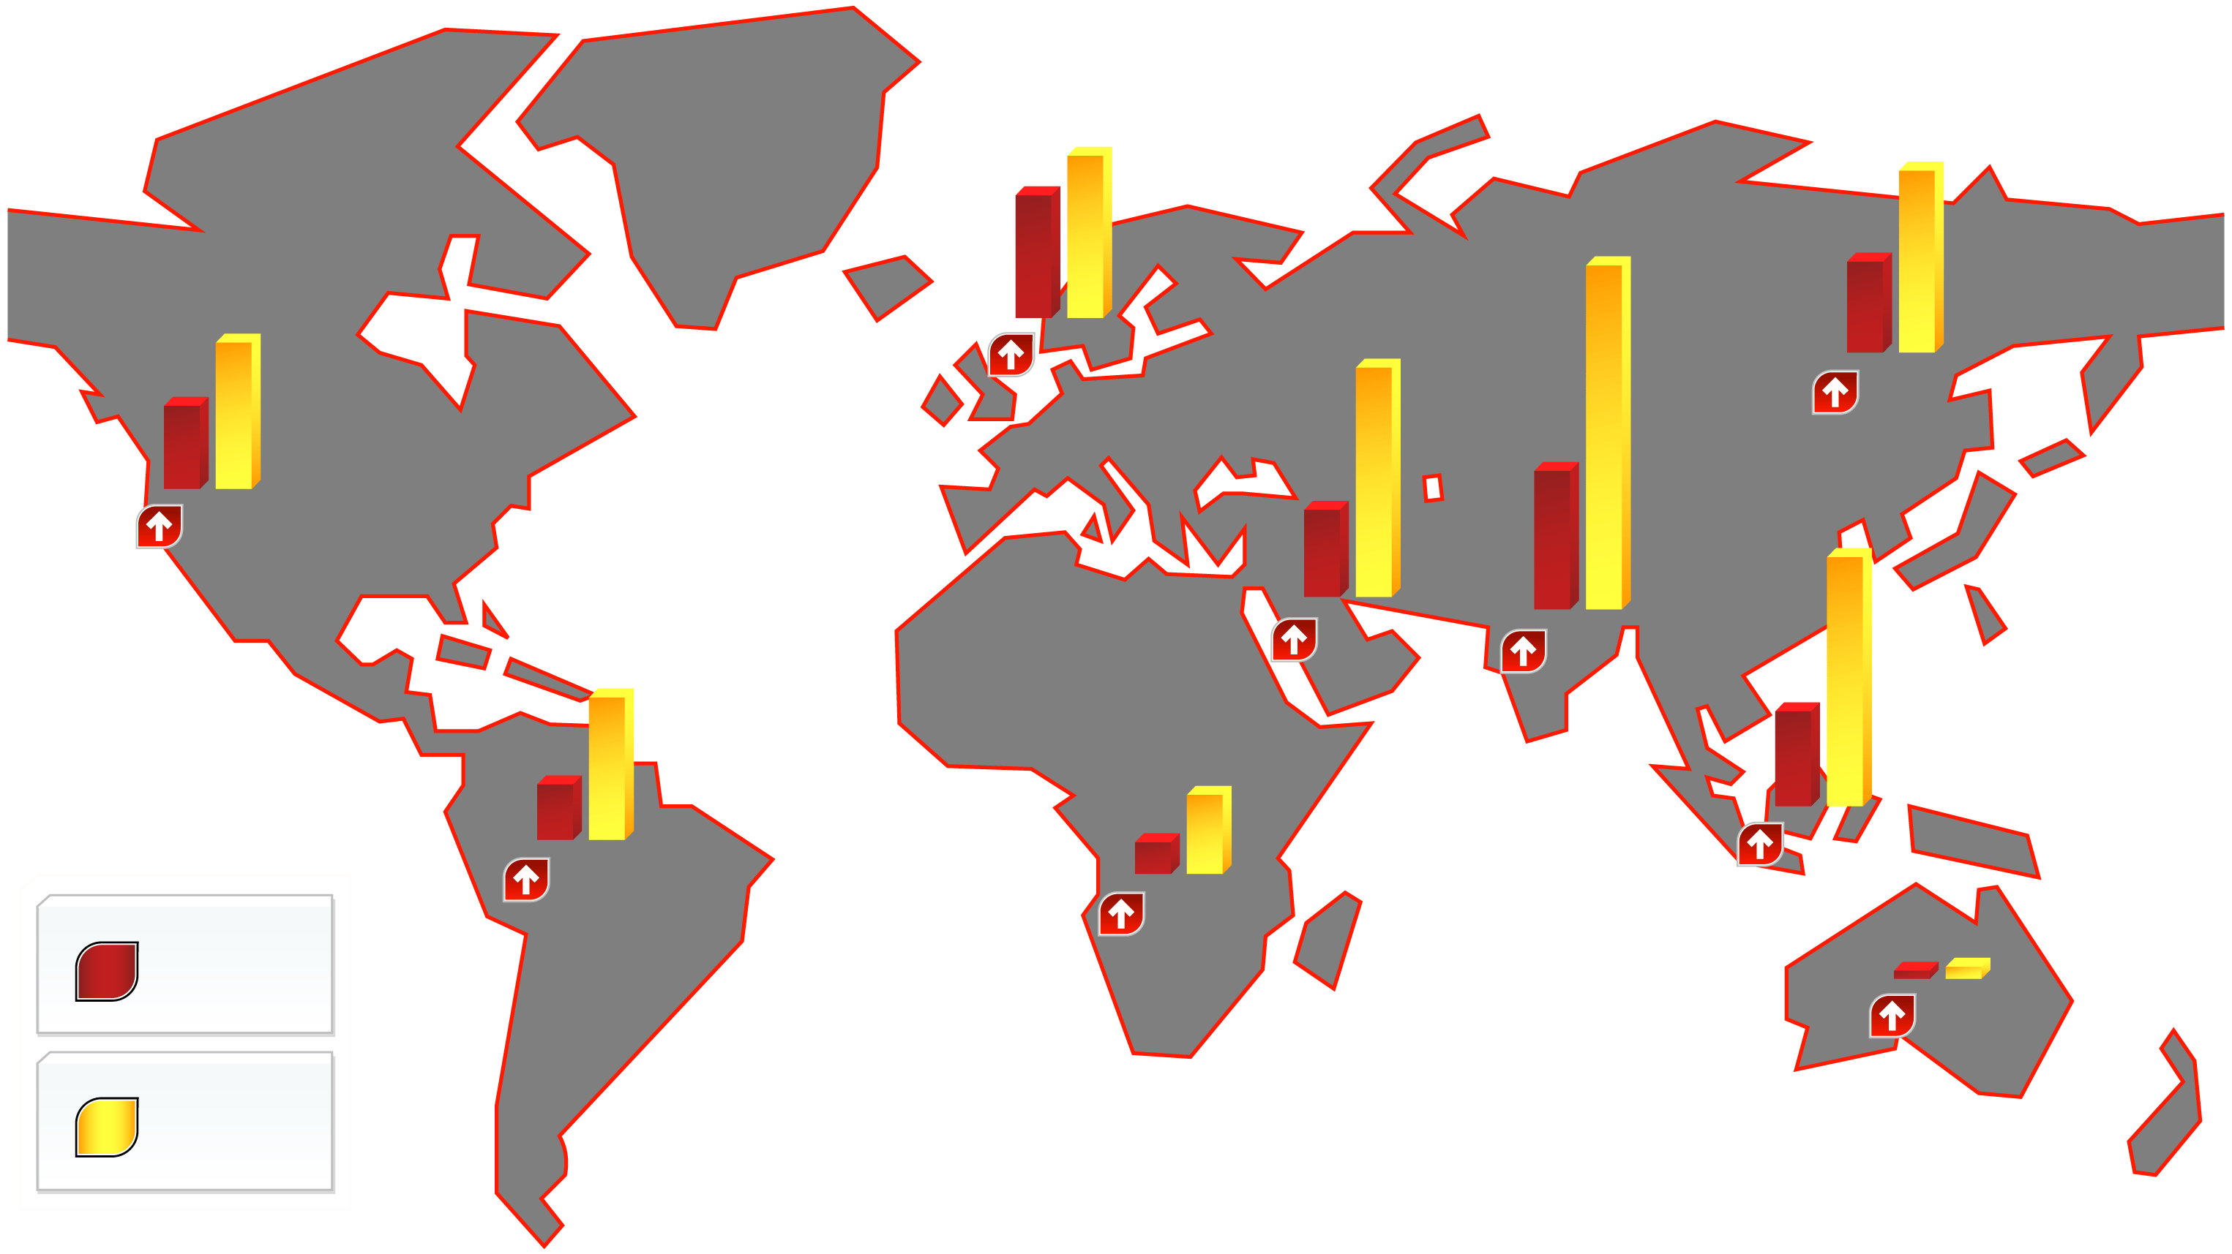
WORLDWIDE PREVALENCE OF DIABETES IN 2000 AND ESTIMATES FOR THE YEAR 2030 (IN MILLIONS)
28.3
37.4
20.7
42.3
31.7
79.4
19.7
33.9
32%
20.0
52.8
China
Europe
Middle East
104%
United States and Canada
72%
22.3
58.1
Sub-Saharan Africa
164%
150%
Southeast Asia
13.3
33.0
India
7.1
18.6
161%
148%
Latin America and Carabbean
162%
0.9
1.7
2000
89%
2030
Australia
Adapted from Hossain P et al. N Engl J Med 2007; 356: 213-5

