Slide 1
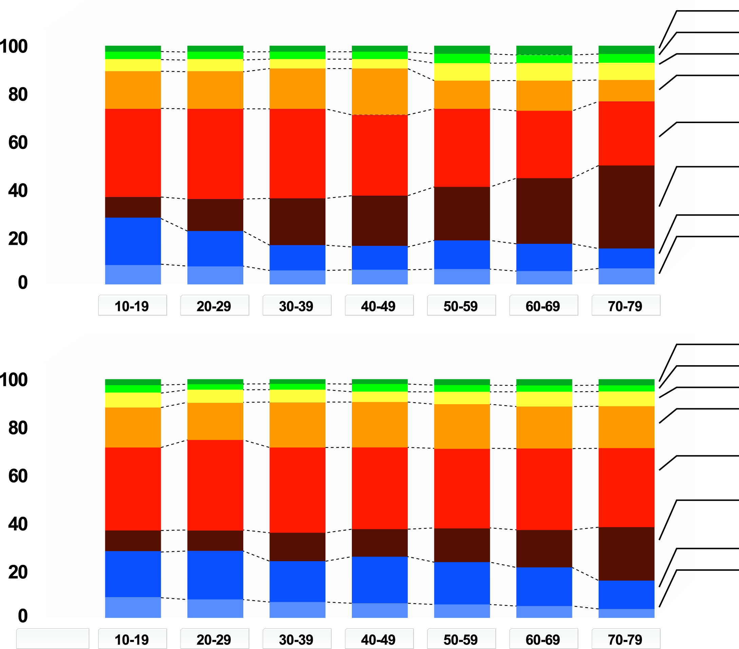
AGE-RELATED CHANGES IN INTRA-ABDOMINAL ADIPOSE TISSUE DISTRIBUTION IN (a) MEN AND (b) WOMEN
(a)
Head
Forearm
Upper arm
Chest
Abdomen
(subcutaneous)
Abdomen
(intra-abdominal)
Thigh
Calf
Age (years)
Relative segmental fat volume (%)
(b)
Head
Forearm
Upper arm
Chest
Abdomen
(subcutaneous)
Abdomen
(intra-abdominal)
Thigh
Calf
Age (years)
From Kotani K et al. Int J Obes 1994; 18: 207-12
Reproduced with permission

