Slide 1
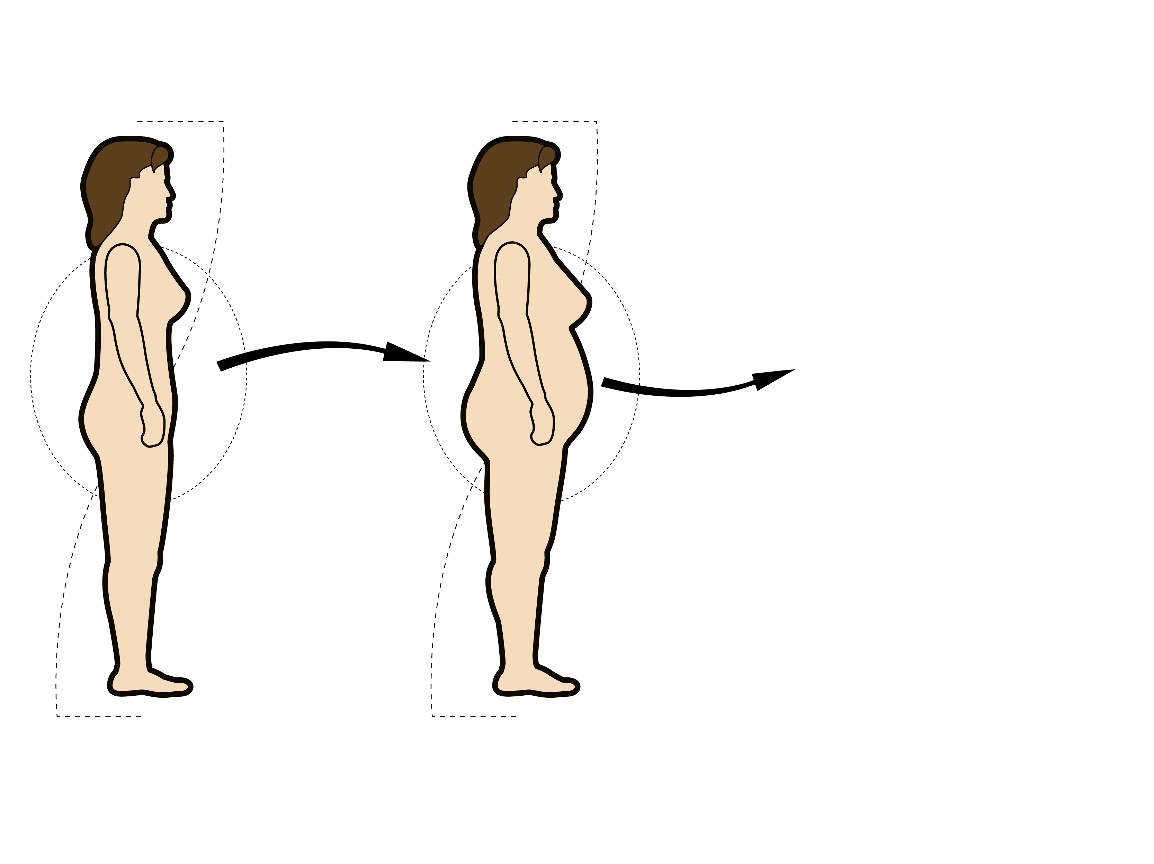
DEVELOPMENT OF AN ATHEROGENIC PROFILE ASSOCIATED WITH MENOPAUSE-RELATED GAIN IN INTRA-ABDOMINAL ADIPOSITY
Insulin resistance
Apolipoprotein B
Menopause
CHD risk
Triglycerides
HDL cholesterol
LDL size
Pre-menopausal women
Post-menopausal women

