Slide 1
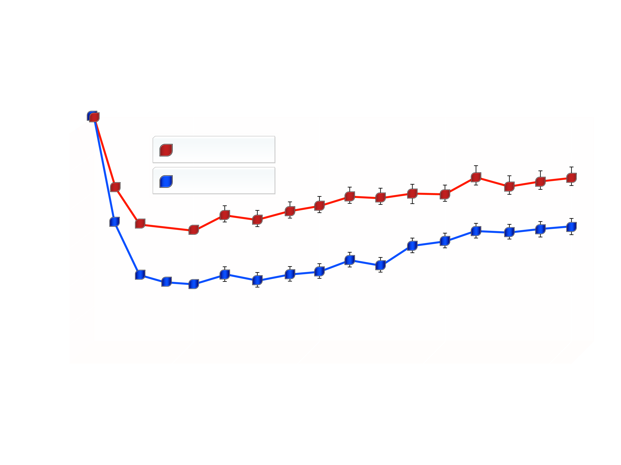
EFFECT OF ORLISTAT ON BODY WEIGHT IN A FOUR-YEAR RANDOMIZED, PLACEBO-CONTROLLED CLINICAL TRIAL
XENDOS Study
0
Placebo
Orlistat
-5
Weight Loss (kg)
-10
-15
0
52
104
156
208
Weeks of Treatment
From Torgerson JS et aI. Diabetes Care 2004; 27: 155-61
Reproduced with permission

