Slide 1
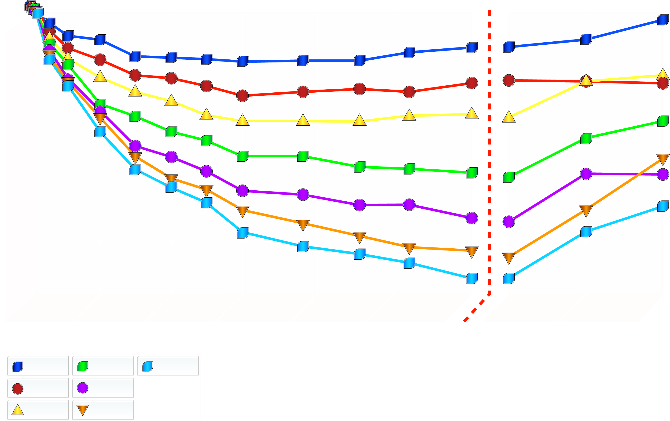
EFFECT OF A SIX-MONTH TREATMENT WITH SIBUTRAMINE ON BODY WEIGHT
End of
Treatment
0
-2
-4
Mean % Change in Weight
-6
-8
-10
0
4
8
12
16
20
24
24
27
30
Placebo
10 mg
30 mg
Treatment Week
1 mg
15 mg
5 mg
20 mg
From Bray GA et aI. Obes Res 1999; 7: 189-98
Reproduced with permission

