Slide 1
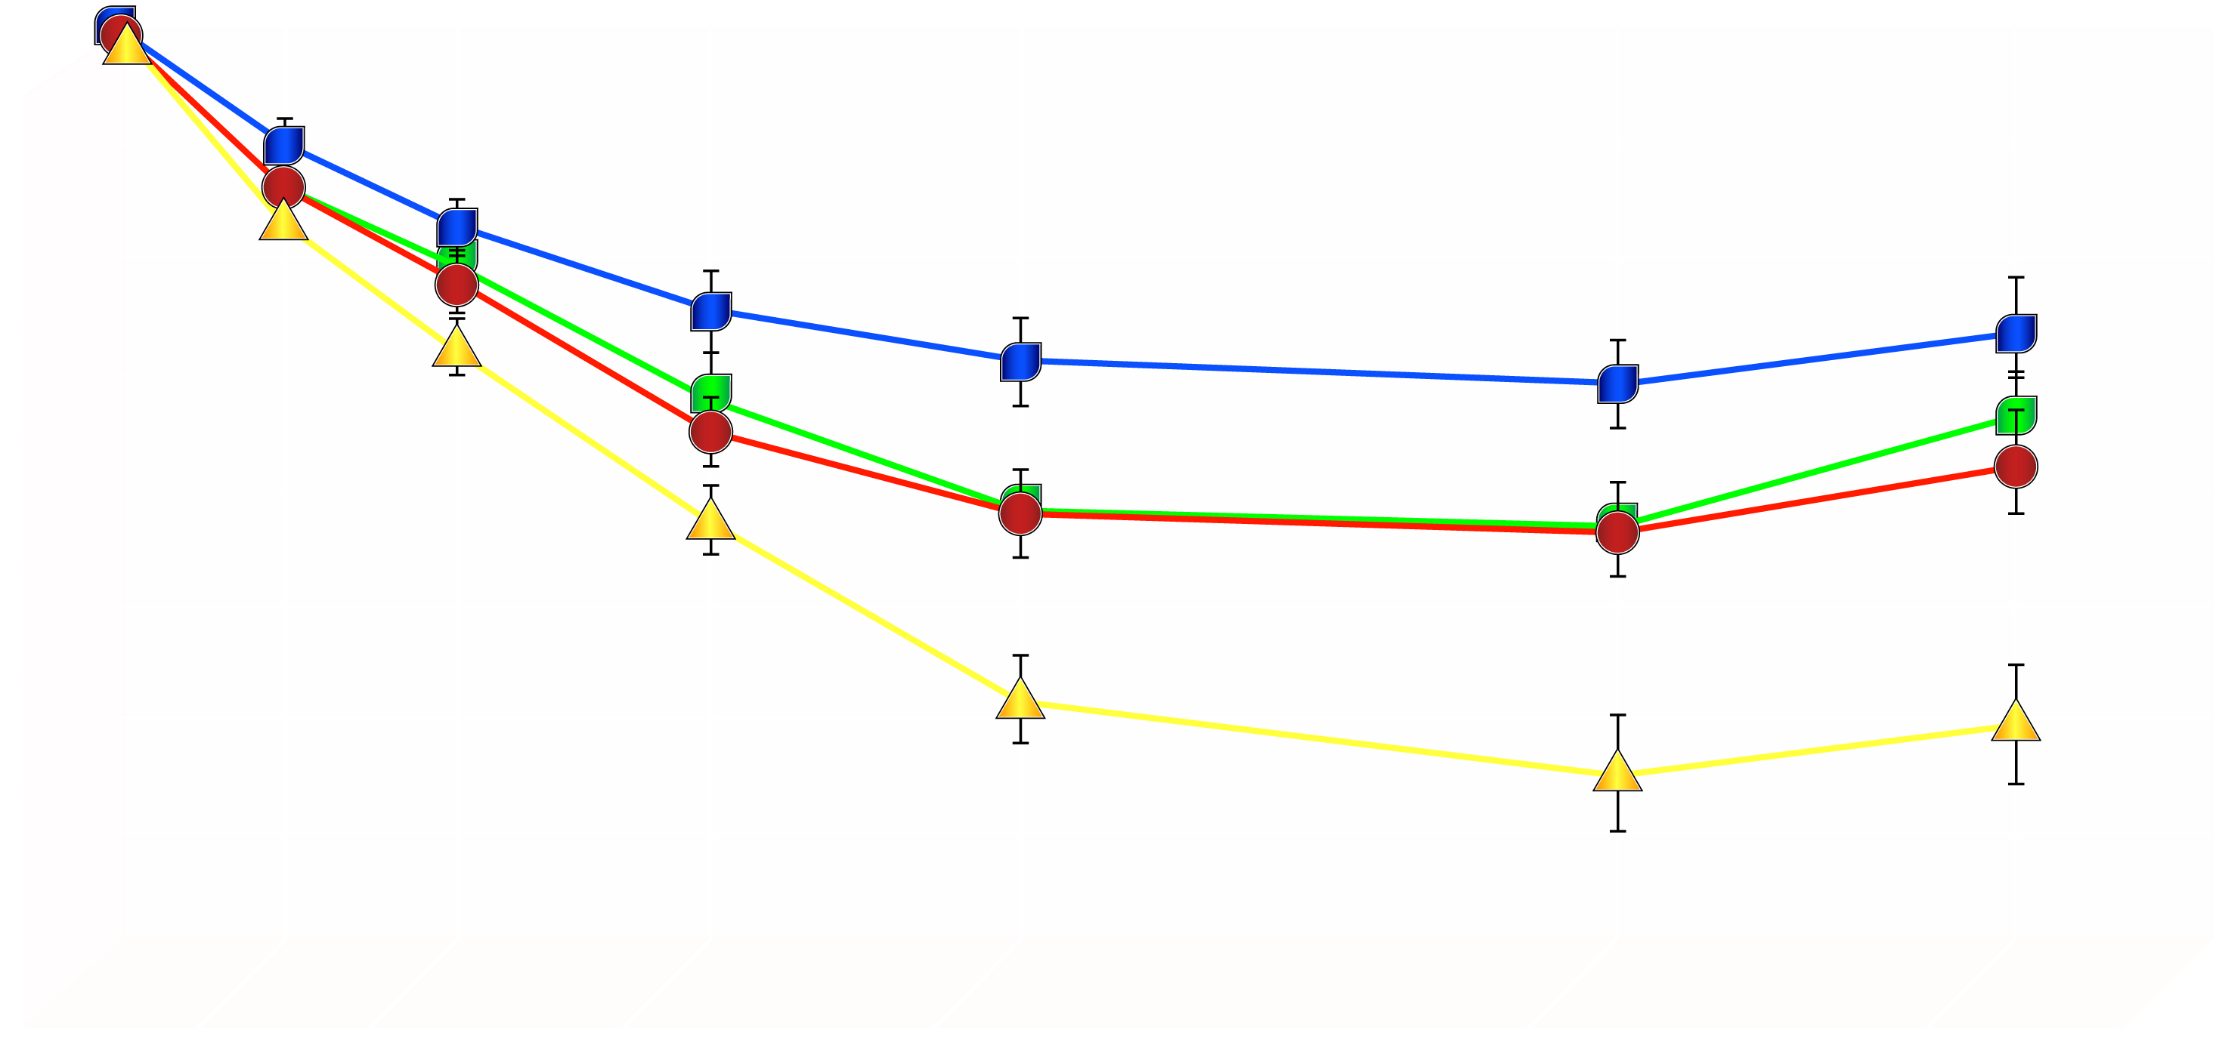
EFFECT OF ADDING A LIFESTYLE MODIFICATION PROGRAM TO SIBUTRAMINE THERAPY ON BODY WEIGHT LOSS
Sibutramine alone
Sibutramine + brief therapy
Lifestyle modification alone
Combined therapy
0
2
4
6
Weight Loss (kg)
8
10
12
14
16
0
3
6
10
18
40
52
Weeks of Treatment
From Wadden TA et al. N Engl J Med 2005; 353: 2111-20
Reproduced with permission

