Slide 1
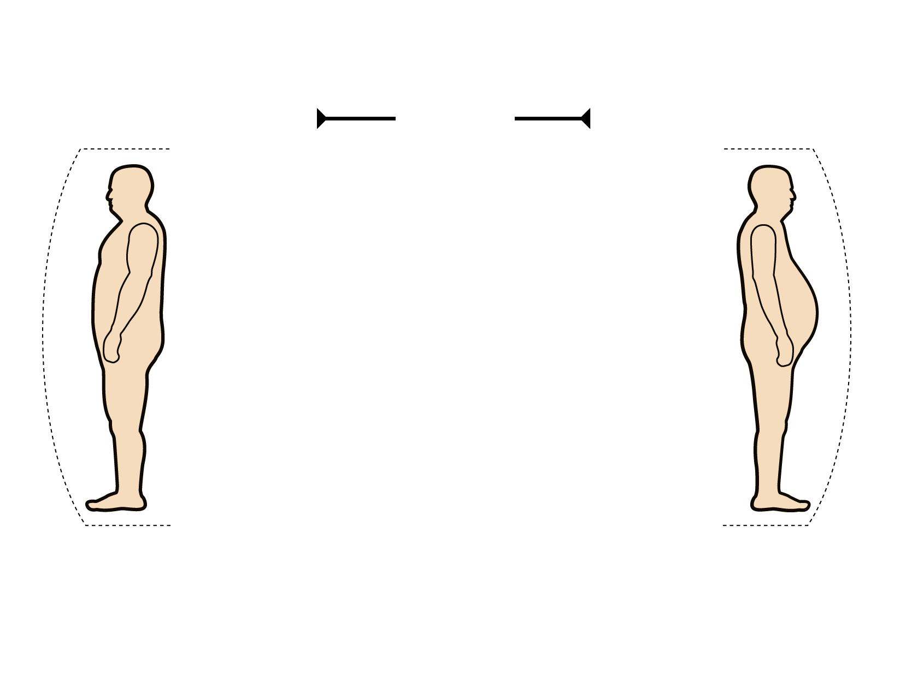
OBESE INDIVIDUALS WITH A PREFERENTIAL ACCUMULATION OF INTRA-ABDOMINAL ADIPOSE TISSUE (AT): SUBGROUP AT HIGH CVD RISK
Same BMI
>30 kg/m²
Gynoid Obesity
Android Obesity
Intra-abdominal AT
Intra-abdominal AT
Subcutaneous AT
Subcutaneous AT
Normal Metabolic Profile
Altered Metabolic Profile
- Low Trlglycerides
- Normal HDL Cholesterol
- Insulin Sensitive
- Normal Glucose Tolerance
- Normal lnflammatory and
Thrombotic Profile
- Hypertriglyceridemia
- Low HDL Cholesterol
- Insulin Resistance
- Glucose Intolerance
- Pro-inflammatory and
Pro-thrombotic Profile
NO METABOLIC SYNDROME
METABOLIC SYNDROME
CVD RISK
CVD RISK

