Slide 1
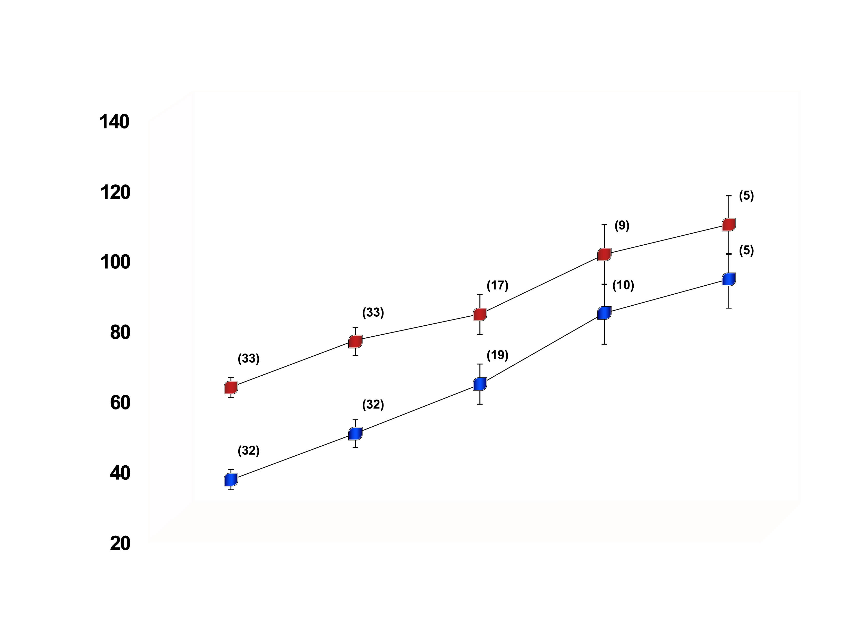
FOUR-YEAR CHANGES IN INTRA-ABDOMINAL ADIPOSE TISSUE IN WHITE VS. AFRICAN-AMERICAN WOMEN
White women
African-American
women
(n): Number of subjects
Intra-abdominal adipose tissue (cm²)
p<0.01 for time effect
p<0.001 for race effect
Baseline
Year 1
Year 2
Year 3
Year 4
From Lara-Castro C et al. Obes Res 2002; 10: 868-74
Reproduced with permission

