Slide 1
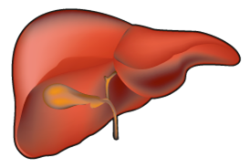
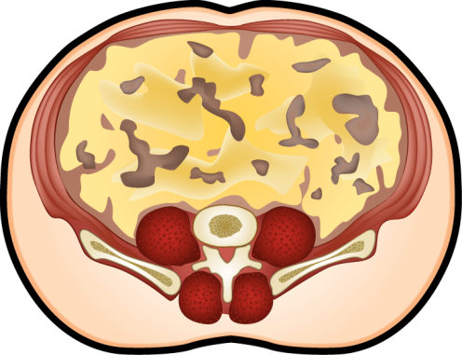
INDEPENDENT ASSOCIATIONS BETWEEN LIVER FAT, INTRA-ABDOMINAL FAT AND CARDIOMETABOLIC RISK
Increased liver fat
deposition
Positive
Energy
Balance
Cardiometabolic
Risk
?
Expanded intra-abdominal
fat depot

