Slide 1
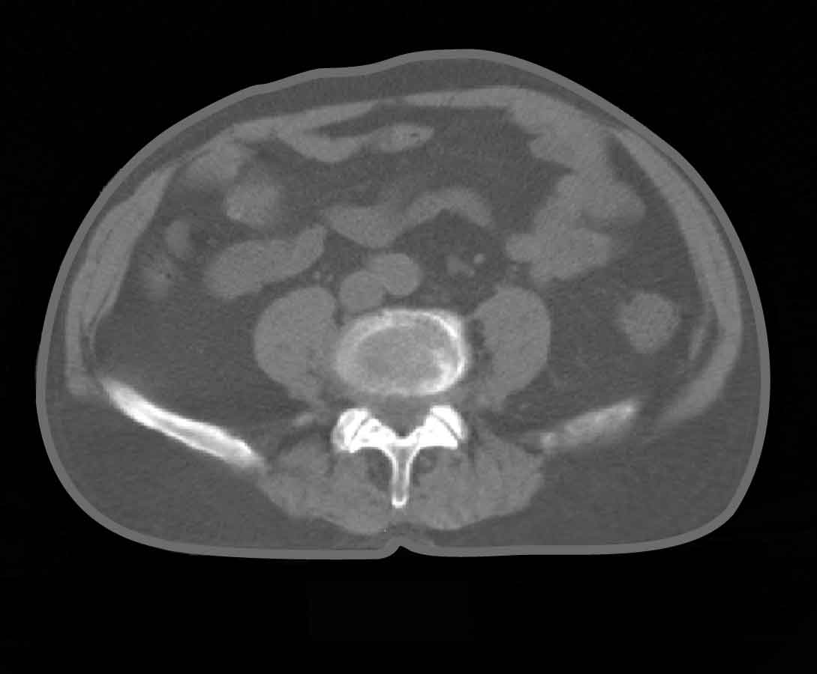
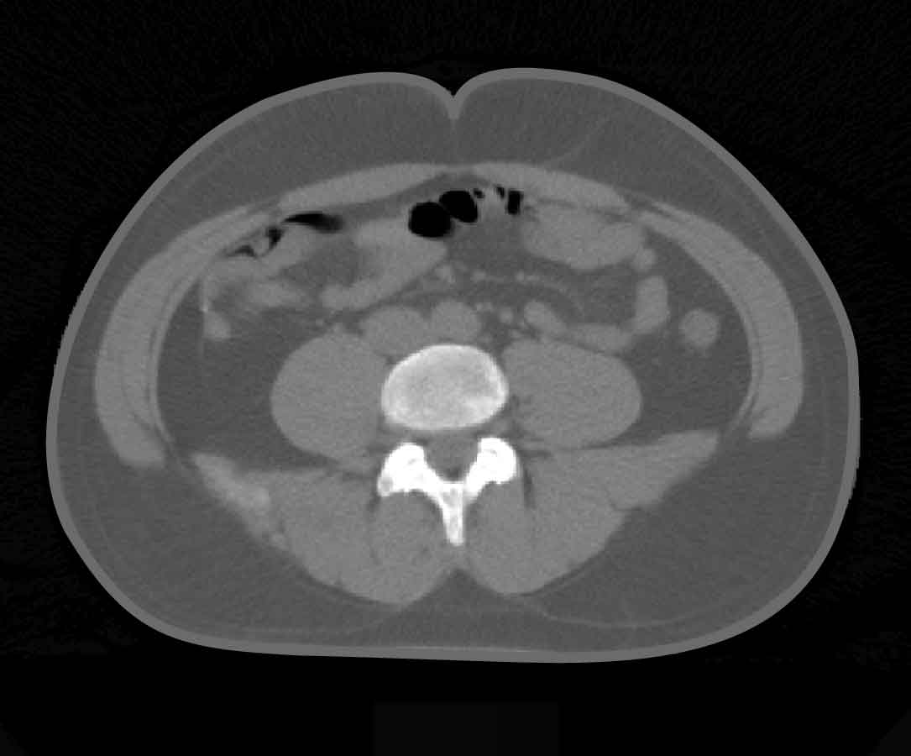
INTRA-ABDOMINAL FAT IN ELDERLY VERSUS YOUNG MEN WITH THE SAME WAIST CIRCUMFERENCE
82 years old
37 years old
• Waist Circumference: 91 cm
• Intra-abdominal Fat: 190 cm²
• Subcutaneous Fat: 162 cm²
• Waist Circumference: 93 cm
• Intra-abdominal Fat: 98 cm²
• Subcutaneous Fat: 274 cm²

