Slide 1
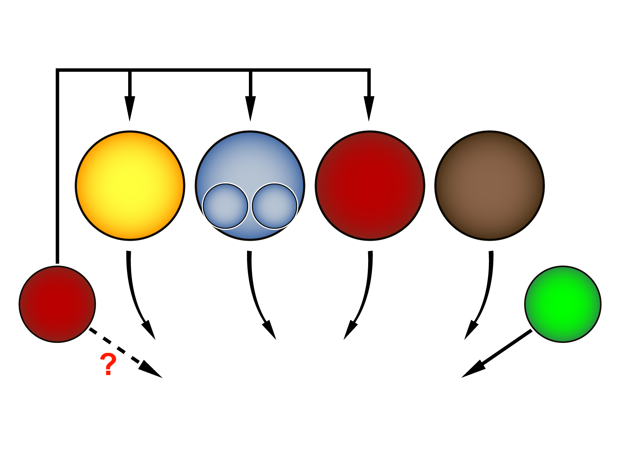
OBESITY AS A MODIFIABLE CARDIOVASCULAR DISEASE (CVD) RISK FACTOR
Cholesterol
Hypertension
Diabetes
Smoking
LDL
HDL
Obesity
BMI
Others
Global CVD risk

