Slide 1
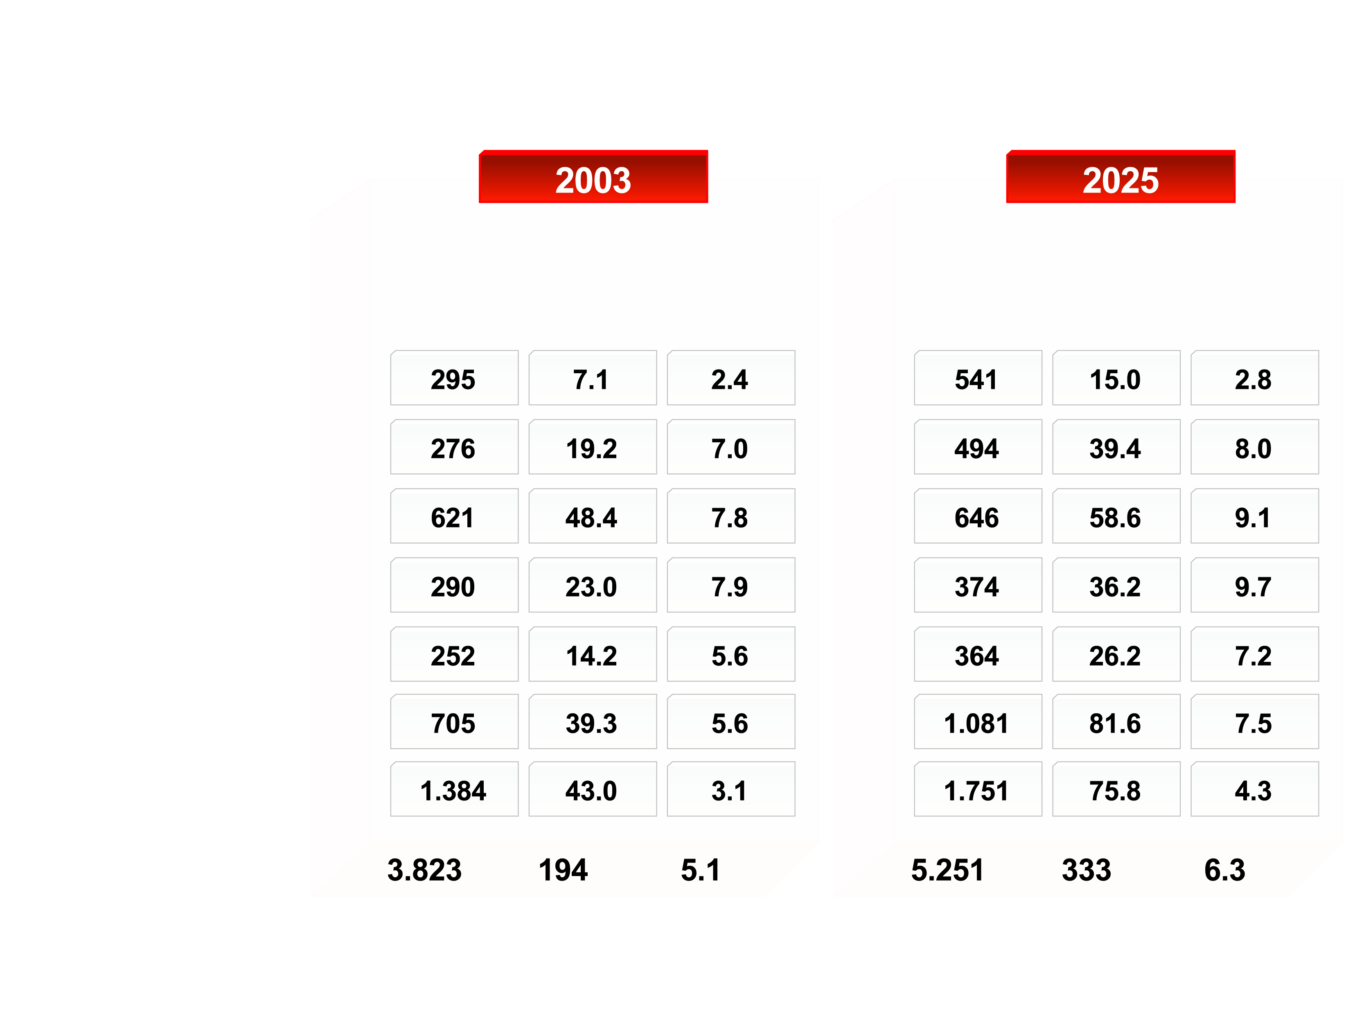
REGIONAL ESTIMATES FOR DIABETES (20-79 AGE GROUP), 2003 AND 2025
Population (20-79 group) (million)
No. of people with diabetes (million)
Prevalence (%)
Population (20-79 group) (million)
No. of people with diabetes (million)
Prevalence (%)
African Region
Eastern Mediterranean and Middle East Region
European Region
North American Region
South and Central American Region
Southeast Asian Region
Western Pacific Region
Total
From Intemational Diabetes Federation (IDF)
http://www.eatlas.idf.org/Prevalence/AlI_diabetes/
Reproduced with permission

