Slide 1
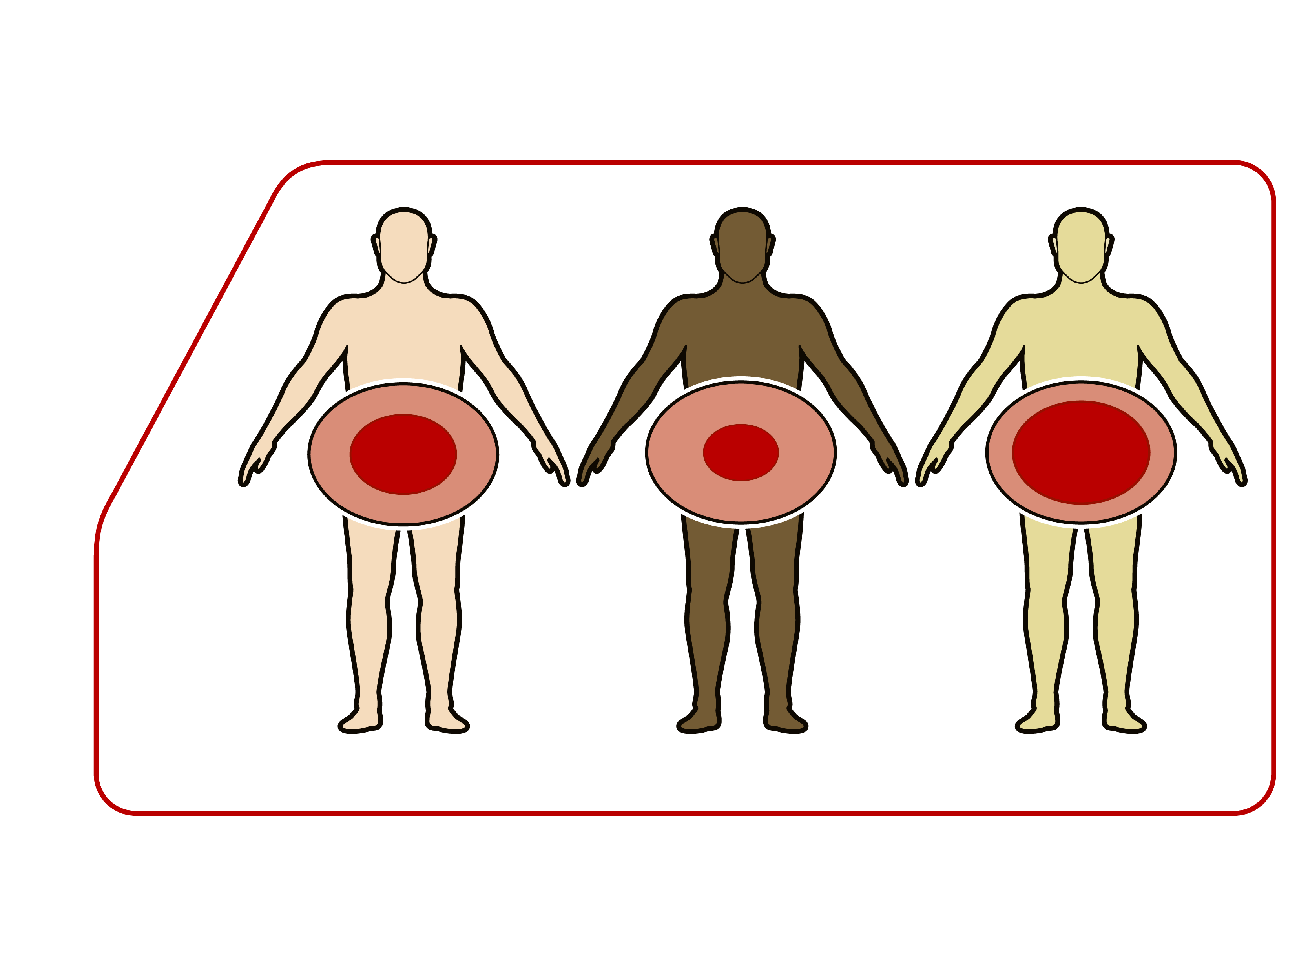
RELATIVE ACCUMULATION OF INTRA-ABDOMINAL VS. SUBCUTANEOUS DEPOT ACCORDING TO ETHNICITY
Intra-abdominal
depot
Subcutaneous
depot
Caucasians
Blacks
Asians

