Slide 1
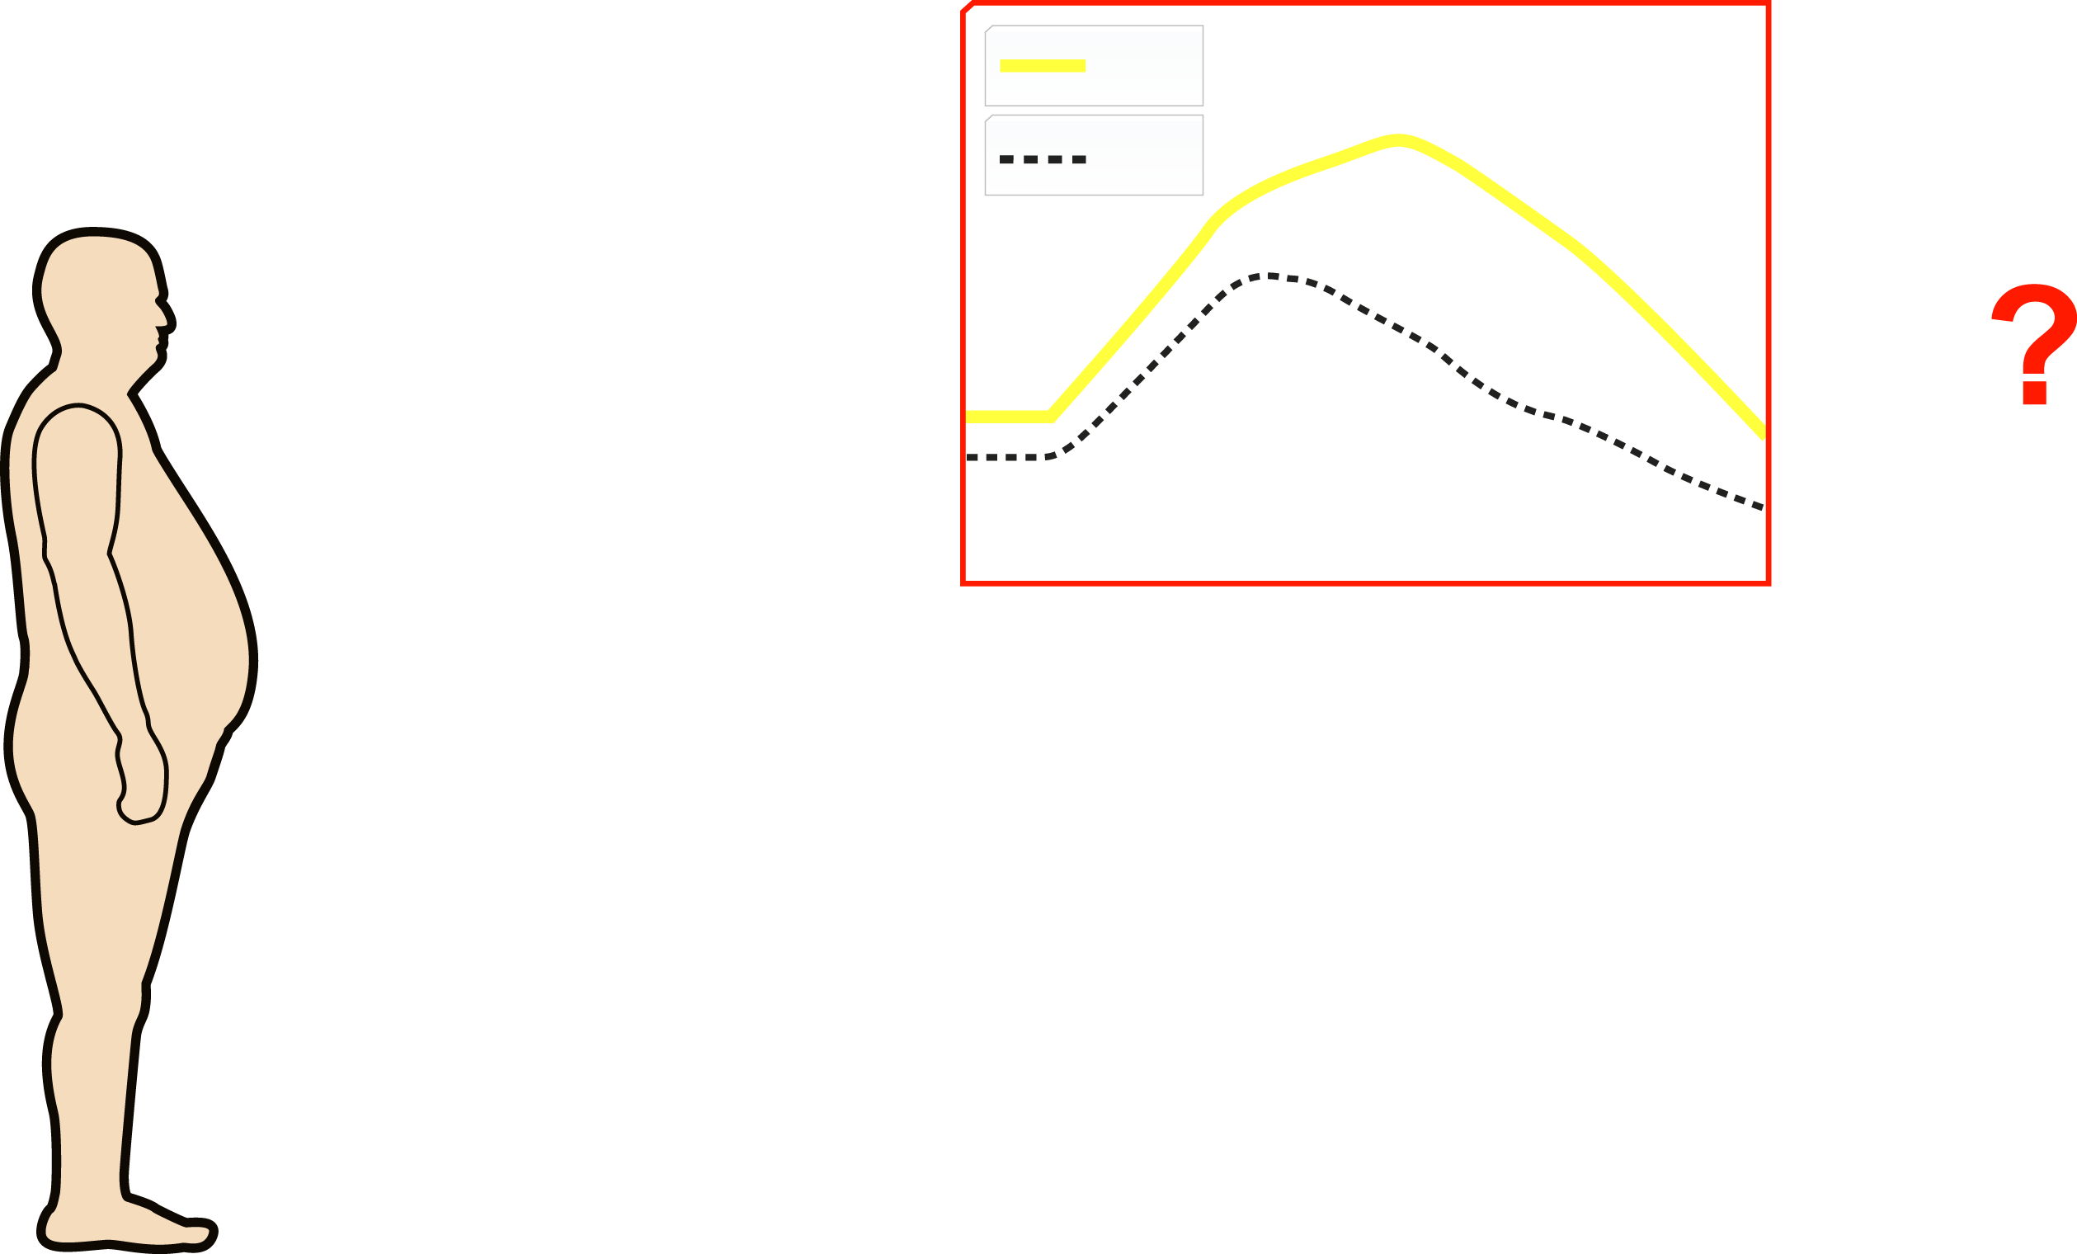
RESPECTIVE CONTRIBUTION OF TYPE 2 DIABETIC HYPERGLYCEMIA VERSUS THE CLUSTERING OF ABDOMINAL OBESITY-RELATED RISK FACTORS (METABOLIC SYNDROME) TO THE INCREASED CORONARY HEART DISEASE (CHD) RISK IN DIABETES
IGT
NGT
Glycemia
75g OGTT
Time
CHD RISK
Metabolic
Syndrome
Abdominal Obesity
Insulin Resistance
Atherogenic Dyslipidemia
Impaired Fibrinolysis
Pro-thrombotic State
Patient with
Abdominal Obesity
and Type 2 Diabetes
Inflammation
Increased Blood Pressure

