Slide 1
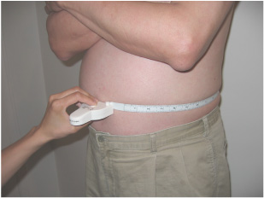
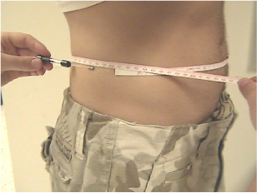
TECHNICIAN-MEASURED WAIST CIRCUMFERENCE USING A MYOTAPE (A) OR A GULICK TAPE (B)
A
B

