Slide 1
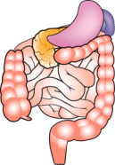
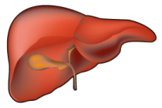
THE ENDOCANNABINOID SYSTEM AND CARDIOMETABOLIC RISK
Excess food intake - obesity
Overactivity of the EC system
Brain
CB₁
Gastrointestinal tract
Food intake
?
Genetic susceptibility?
CB₁
Abdominal adiposity
FFA
Liver
Adipocytes
Skeletal muscle?
Adiponectin
FFA
CB₁
TNF-α
CB₁
CB₁
IL-6
CRP
Lipogenesis
LPL
Lipogenesis
Impaired insulin action
Liver fat
VLDL
Glucose production
Insulinemia
Insulin degradation
Apo AI synthesis
Glucose intolerance
Increased waist (abdominal obesity)
Insulin resistance
High triglyceride-low HDL choIesteroI dyslipidemia
Pro-inflammatory profile
Risk of CVD and type 2 diabetes
Adapted from Després JP et al. Int J Obes 2006; 30: S44-52

